Slide 1

Lecture 13
ALGORITHMS & DATA STRUCTURES
DEPARTMENT OF COMPUTING
January 28, 2019

Slide 2
Outline
Review of last week
Graphs
Spanning trees
Path finding

Slide 3
Outline
Review of last week
Graphs
Spanning trees
Path finding

Slide 4
Hashing Quiz
Final marks (30+70*(score/10)²
13 students did not attempt the quiz ☹
45 students over 90 ☺

Slide 5
Binary Search Lab. Submission
20 students (out of 141) did not submit ☹
76 students over 90 ☺
Next two lab submissions require more work. Please, start as soon as possible

Slide 6
Binary Search Quiz
Still open(closes at 4pm on Friday 1st February )
If you have not attempted the quiz yet, please start as soon as possible. The next two weeks will be intensive with heap lab and coming graphs lab

Slide 7
Schedule Term2 (first half)
Mon Tue Wed Thu Fri
Week 11
14-Jan 15-Jan 16-Jan 17-Jan 18-Jan
Lecture 11
Week 12
21-Jan 22-Jan 23-Jan 24-Jan 25-Jan
Lecture 12 Lab.12 Lab.12 Hashing quiz
Lab. Submission Binary Search
Office hours 2-4pm
Week 13
28-Jan 29-Jan 30-Jan 31-Jan 01-Feb
Lecture 13 Lab.13 Lab.13 Binary Search quiz
YOU ARE HERE
Office hours 2-4pm
Week 14
04-Feb 05-Feb 06-Feb 07-Feb 08-Feb
Lecture 14 Lab.14 Lab.14 Implicit Data Structures quiz
Lab. Sub.Heap, Heapsort
Office hours 2-4pm
Week 15
11-Feb 12-Feb 13-Feb 14-Feb 15-Feb
Lecture 15 Lab.15 Lab.15 Graphs quiz
Lab. Submission Graphs
ESSAY, Assignment
Office hours 2-4pm
READING WEEK (18-Feb-24Feb)

Slide 8
Last lecture
Implicit heaps
[0]
function PARENT(k)
return FLOOR((k-1)/2)
end function
89
[1]
[2]
function LEFT(k)
return 2×k+1
end function
21
9
[3]
[4]
[5]
[6]
3
14
4
7
function RIGHT(k)
return 2×k+2
end function
[0] [1] [2] [3] [4] [5] [6]
89 | 21 | 9 | 3 | 14 | 4 | 7

Slide 9
Last lecture
Implicit heaps operations
Insert (incremental)
Extract-max!
Build heap (in place)

Slide 10
Last lecture
Implicit heaps operations
Insert (incremental)
Extract-max!
97
97
31
79
31
79
23
14
54
67
23
25
54
67
3
12
4
25
3
12
4
14
Insert lowest level, leftmost
Swap if necessary
Build heap (in place)

Slide 11
Last lecture
Implicit heaps operations
Insert (incremental)
Extract-max!
97
17
31
79
31
79
“Extract” the root
31
79
23
14
54
67
23
25
54
67
23
14
54
67
3
12
4
25
3
12
4
14
3
12
4
7
32
18
44
17
Insert lowest level, leftmost
Swap if necessary
17
31
79
Move last to the root
Build heap (in place)
23
14
54
67
3
12
4
7
32
18
44
17
31
79
Max-Heapify
23
14
54
67
3
12
4
7
32
18
44

Slide 12
Last lecture
Implicit heaps operations
Insert (incremental)
Extract-max!
97
17
31
79
31
79
“Extract” the root
31
79
23
14
54
67
23
25
54
67
23
14
54
67
3
12
4
25
3
12
4
14
3
12
4
7
32
18
44
17
Insert lowest level, leftmost
Swap if necessary
17
31
79
Move last to the root
Build heap (in place)
23
14
54
67
5
[0]
3
12
4
7
32
18
44
[2]
We heapify bottom-up
17
1
[1]
9
31
79
95
[3]
94
[4]
36
[5]
93
[6]
Max-Heapify
23
14
54
67
[7]
[8]
[9]
55
23
47
Leaves are already heaps
3
12
4
7
32
18
44

Slide 13
Last lecture
Heapsort
UNSORTED ARRAY
BUILD-HEAP
MAX-HEAP
EXTRACT-MAX! & COPY AT END
HEAPSORT
Heap
Sorted array
EXTRACT-MAX! & COPY AT END-1
Heap
Sorted array
Sorted array
SORTED ARRAY (ASCENDING ORDER)

Slide 14

How much do you remember?

Slide 15
Outline
Review of last week
Graphs
Spanning trees
Path finding

Slide 16
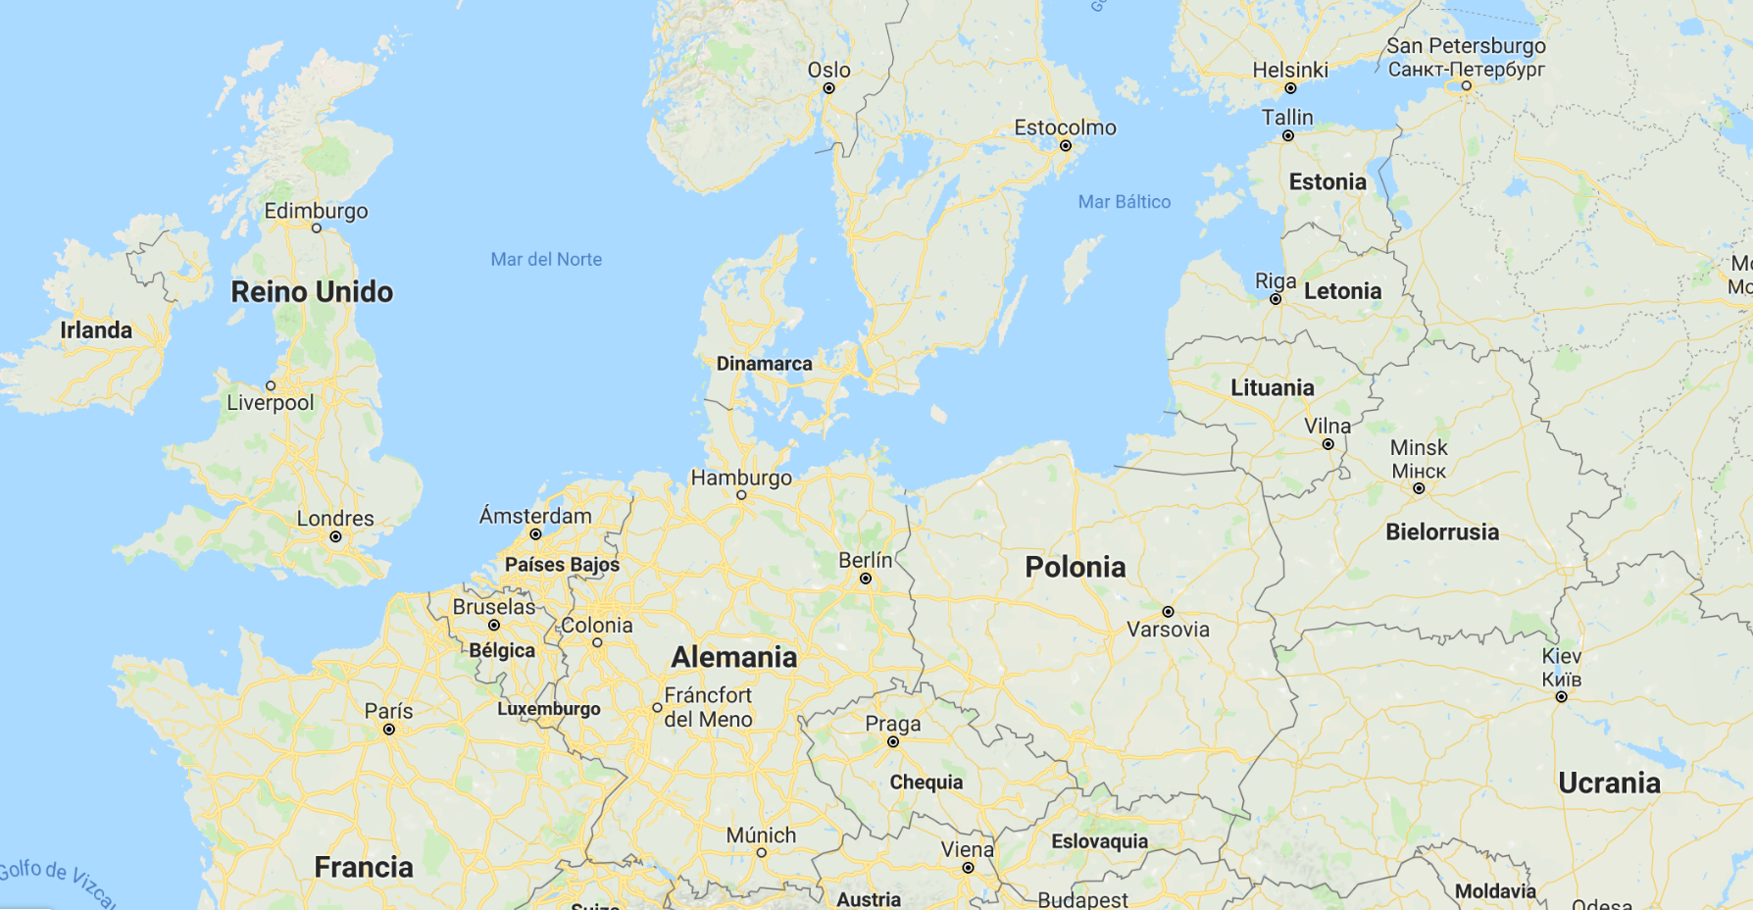
A bit of history
The Russian exclave of Kaliningrad

Slide 17
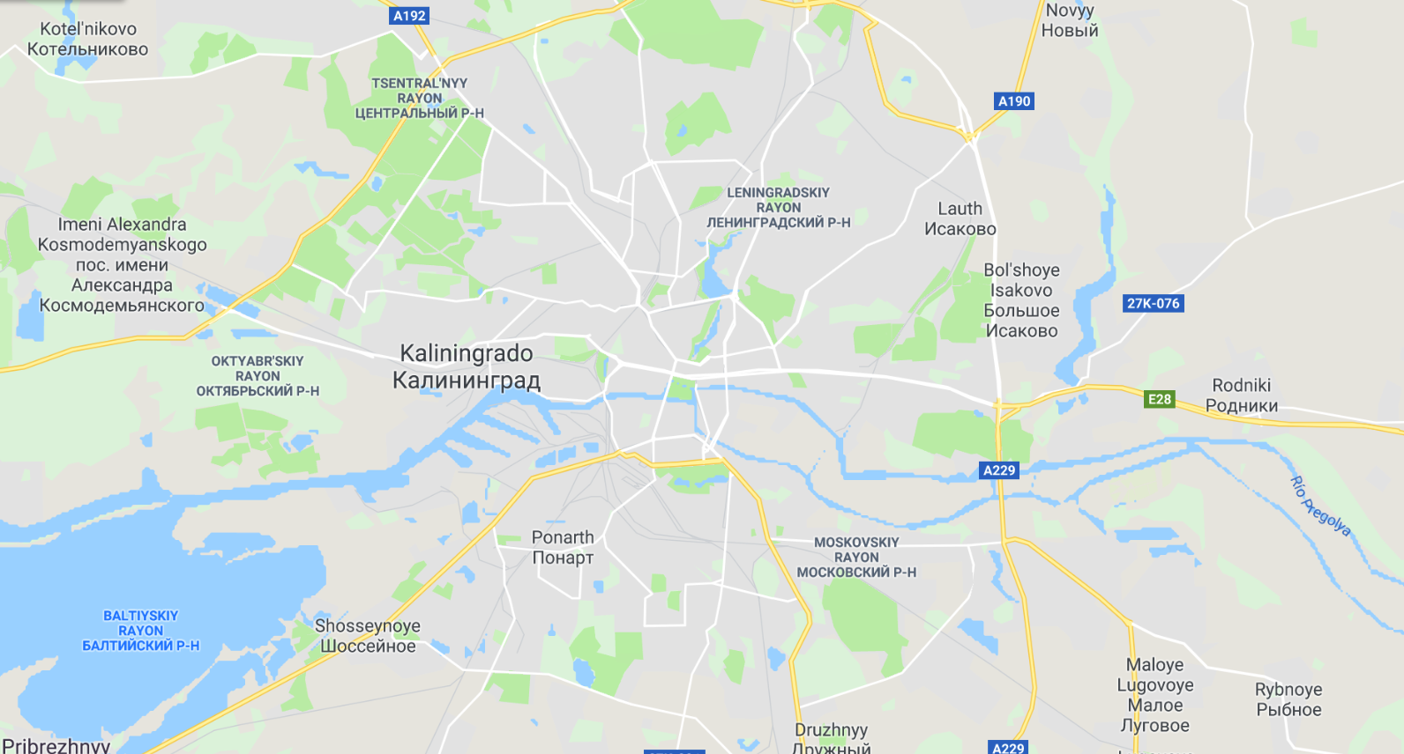
A bit of history
The Russian exclave of Kaliningrad

Slide 18
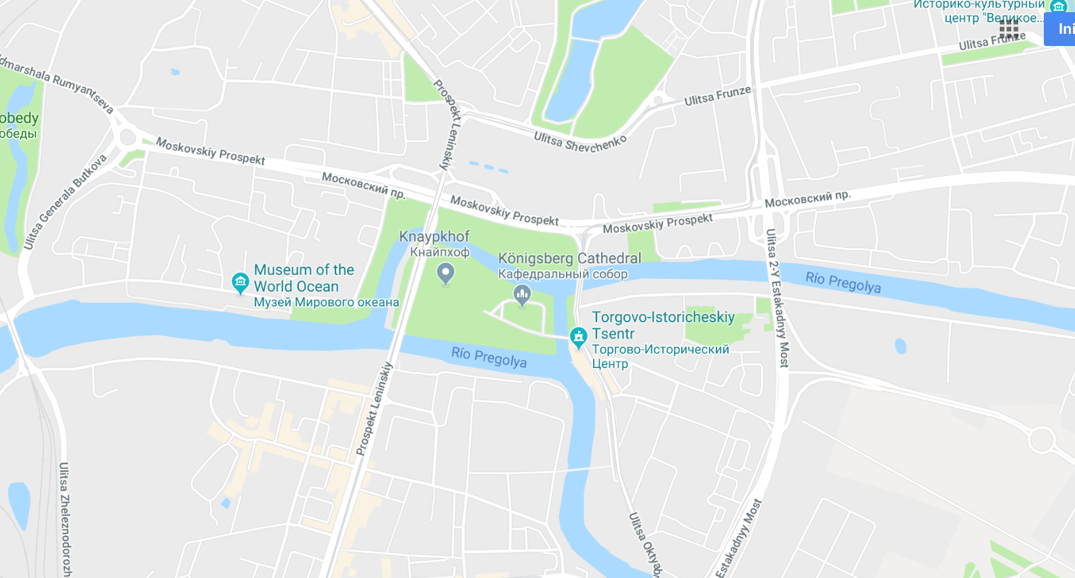
A bit of history
The Russian exclave of Kaliningrad

Slide 19
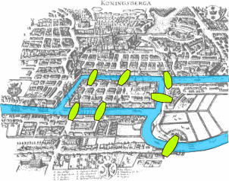
A bit of history
The 7 bridges of Köninsberg (1735)

Slide 20
A bit of history
Can we walk the city crossing every bridge only once?

Slide 21
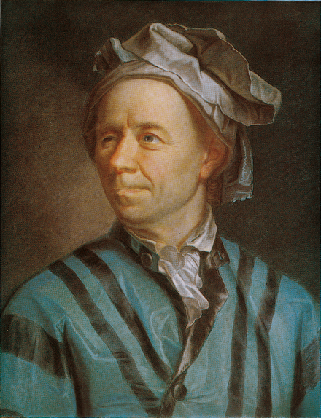
A bit of history
LEONARD EULER (Basel 1707 – St. Petersburg 1783)

Slide 22
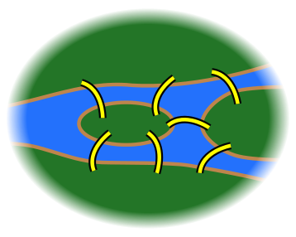
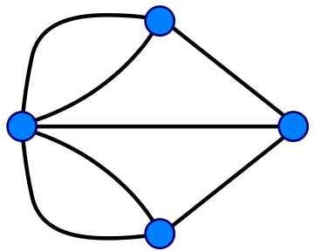
A bit of history
A
A
D
B
B
D
C
C
Graph Theory is born (1735)
https://simple.wikipedia.org/wiki/Seven_Bridges_of_Königsberg

Slide 23
Graphs: a branch of discrete mathematics
Node (vertex)
Link (edge)
Visual representation of interconnected objects

Slide 24
Graph simplest definition
Node (vertex)
Link (edge)
A set of nodes connected by edges

Slide 25
Some graph examples
Les Misérables (Gephi)

Slide 26
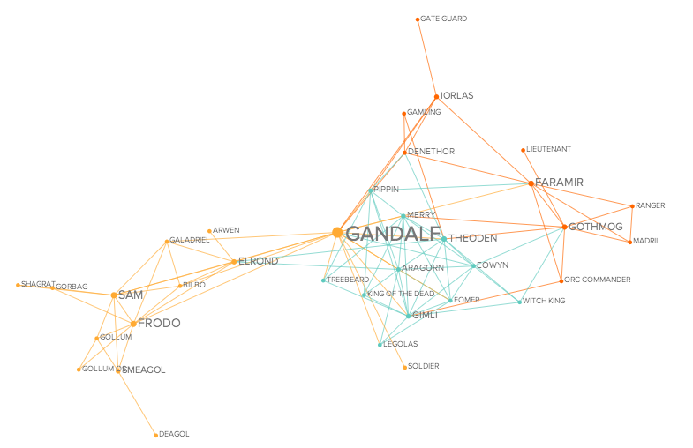
Some graph examples
moviegalaxies.com (being updated right now ☹ )

Slide 27
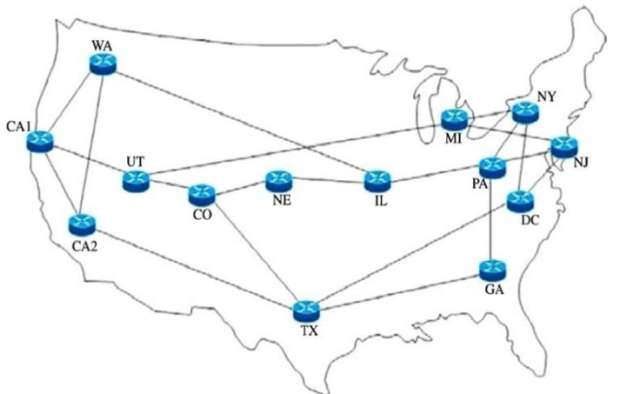
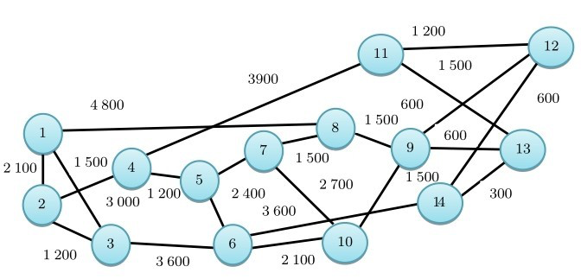
Some graph examples
NSFNET

Slide 28

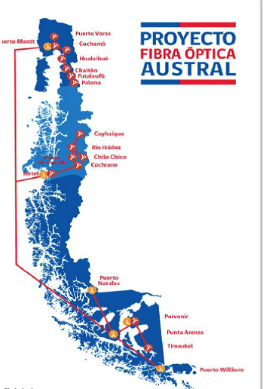
Some graph examples
maps.level3.com (trees are a subset of graphs)

Slide 29

Some graph examples
6 degrees of separation (3.57 according to Facebook 2016)
http://www.bbc.co.uk/newsbeat/article/35500398/how-facebook-updated-six-degrees-of-separation-its-now-357

Slide 30
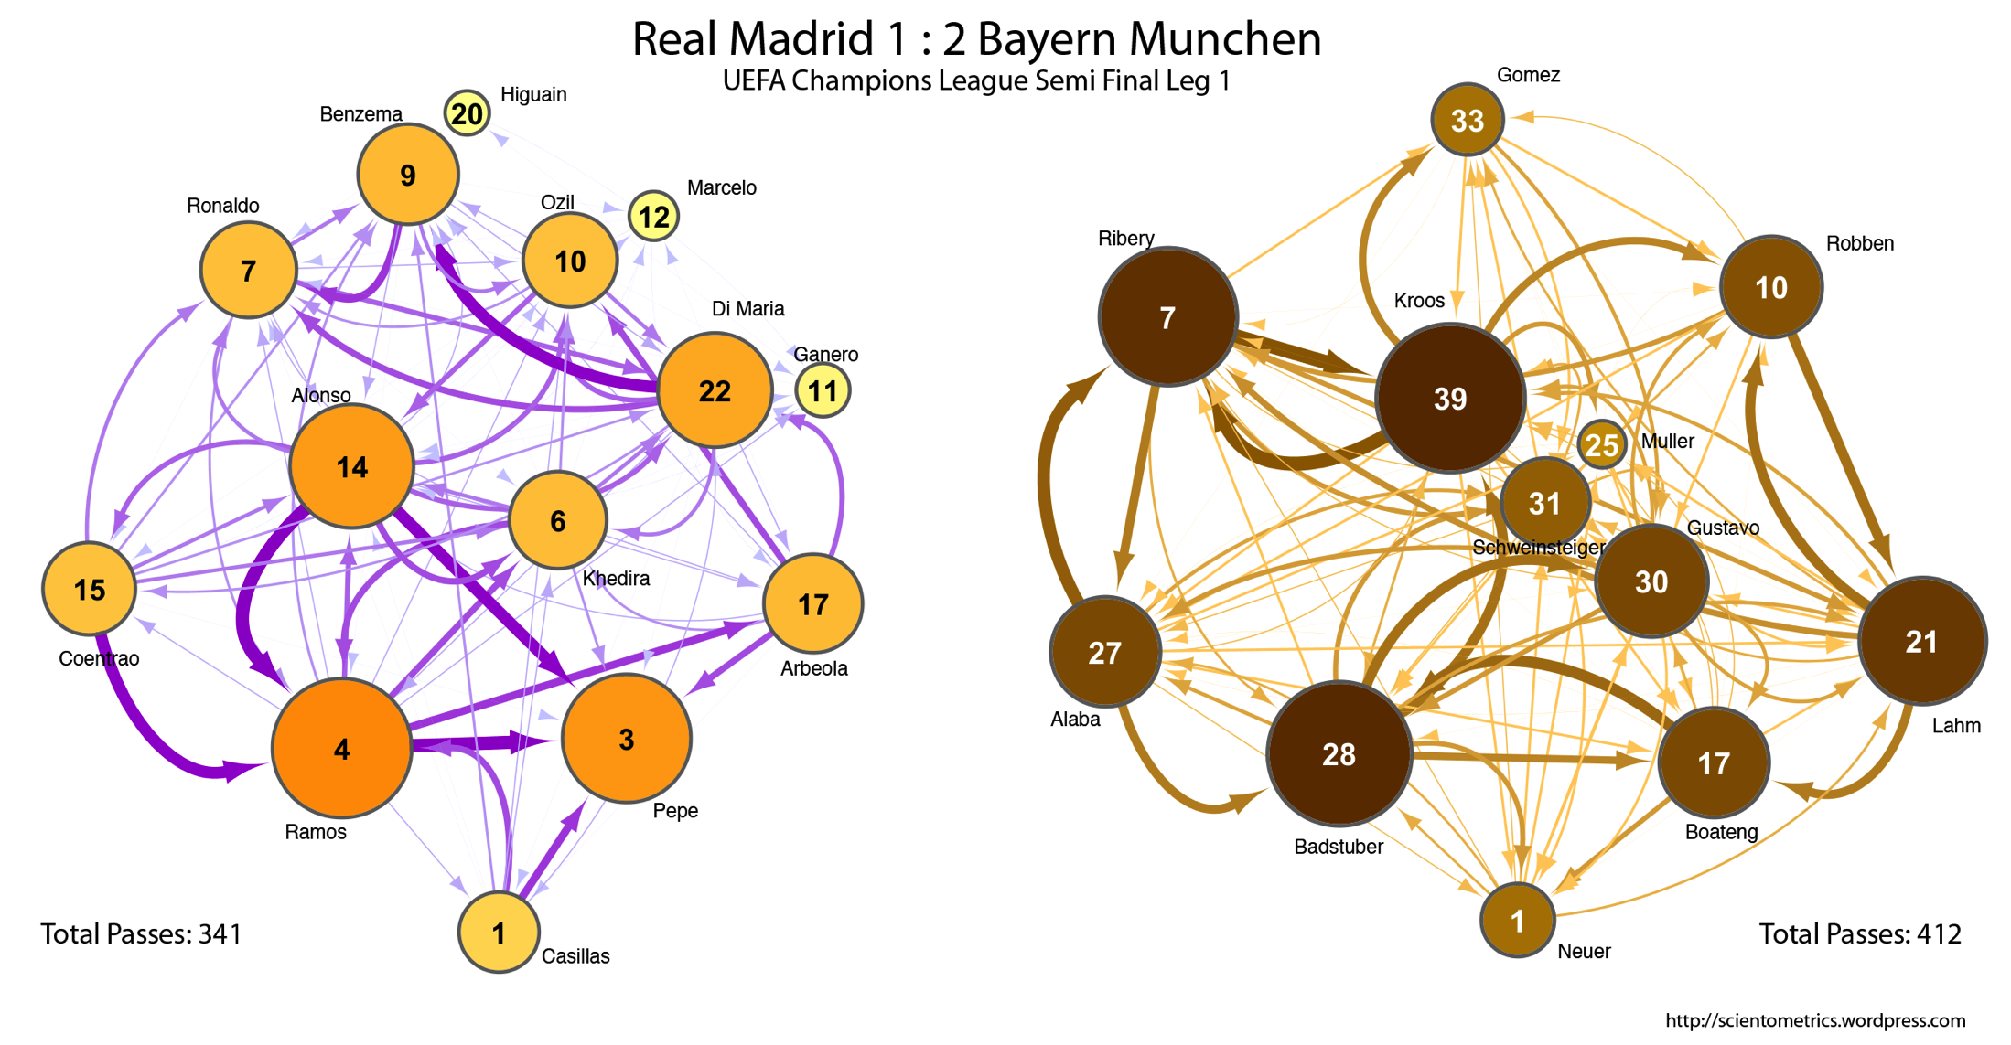
Some graph examples
www.egrafis.com/gambar/munchen-vs-madrid-passing-distribution-r-scientometrics

Slide 31
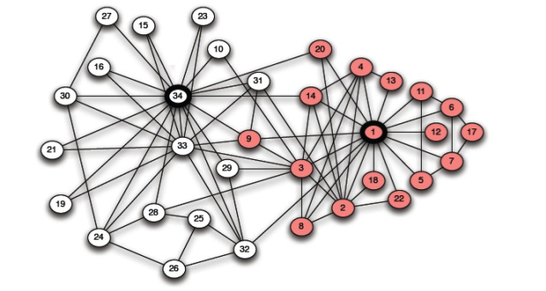
Some graph examples
Zachary karate club
https://ifisc.uib-csic.es/~jramasco/ComplexNets.html

Slide 32
Types of graphs

Slide 33
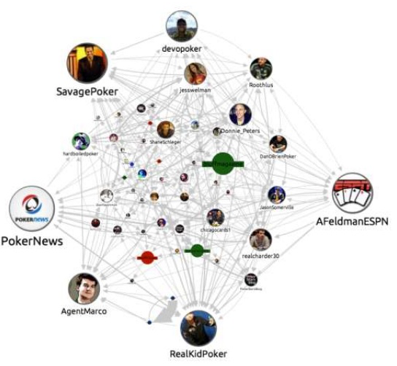
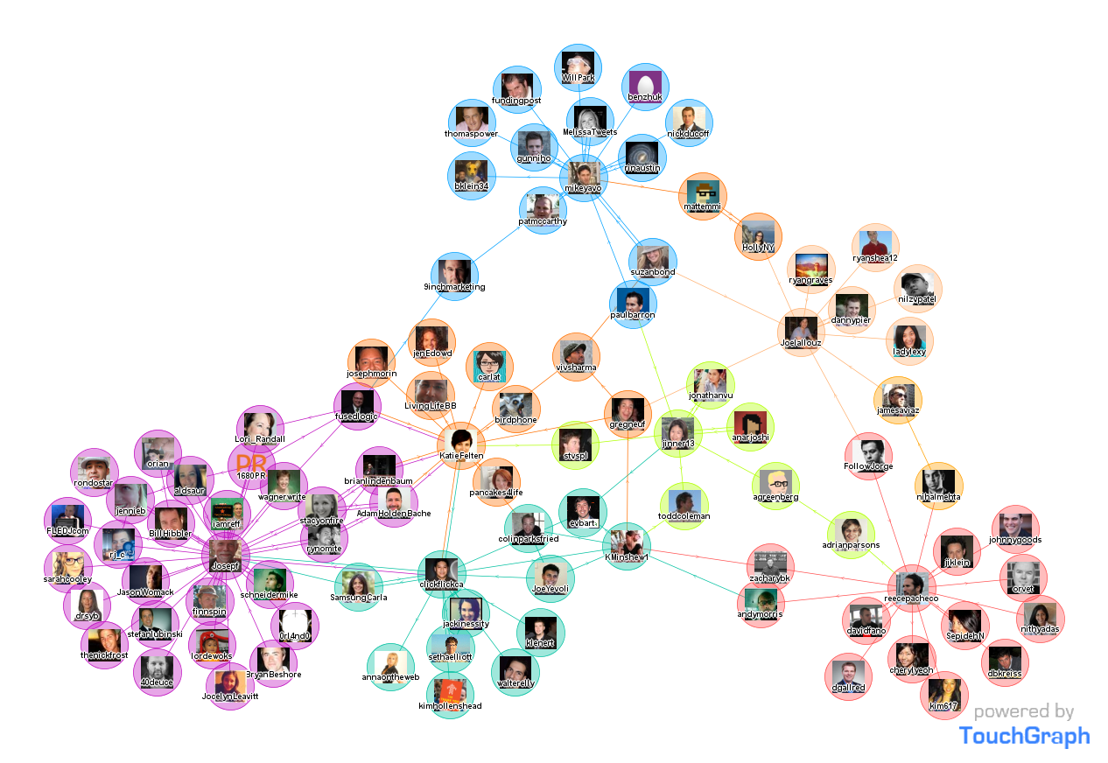
Types of graphs
Twitter: You follow someone who does not follow you back. Twitter’s graph is directed.
Facebook: Friendship is mutual. Facebook’s graph is undirected.
https://www.slideshare.net/neo4j/graphconnect-2014-sf-dynamic-graphs-the-future-of-neo4j-visualization
Directed vs. Undirected : Twitter vs Facebook

Slide 34
Types of graphs
Directed graphs
Undirected graphs
Mary
Ahmed
Mary
Ahmed
John
Ziva
John
Ziva
Raj
Raj
Directed vs. Undirected : Twitter vs Facebook

Slide 35
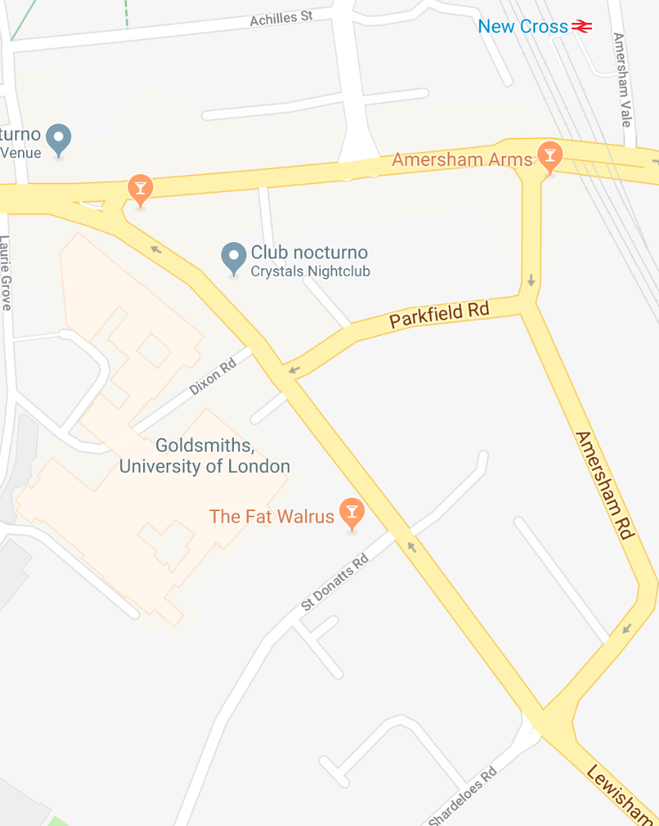
Types of graphs
Road maps are represented as directed graphs

Slide 36
Types of graphs
Amersham Arms
Corner 1
Corner 2
Goldsmiths
Corner 3
Road maps are directed

Slide 37
Types of graphs
Amersham Arms
Corner 1
Amersham Arms
Corner 1
Corner 2
Goldsmiths
Corner 2
Goldsmiths
Corner 3
Corner 3
Road maps are directed

Slide 38
Types of graphs
Cosette
10
9
Judge
1
Valjean
Cosette
8
This is an undirected weighted graph
Weighted vs. Non-weighted (intensity of relationships)

Slide 39
Types of graphs
Corner 1
200 mt
Amersham Arms
Amersham Arms
Corner 1
60 mt
100 mt
Corner 2
85 mt
Goldsmiths
Corner 2
Goldsmiths
180 mt
200 mt
Corner 3
Corner 3
This is an directed weighted graph
Road maps are directed weighted graphs (length of roads)

Slide 40
Types of graphs: typical topologies
RING
MANHATTAN
BUS
TREE
MESH

Slide 41
Summary
Graph: set of vertices (V) connected by edges (E)
Many interconnected systems can be represented with graphs
Graphs can be undirected or directed
Graphs can be weighted (or not)

Slide 42
Representations of graphs: Edge list
J
2
K
1
6
N
10
L
8
M
4
Edge list (+ vertex list)
V={J,K,L,M,N}
E={ (J, K, 2), (K, M, 6), (L, J, 10), (M, L, 8), (M, N, 4), (N, K, 1) }
J
2
K
K
J
8
N
K
L
M
1
6
10
M
4
N
M
L
Space complexity: Θ(E) - considering only the edge list
(E is a simplified way of referring to the number of elements in set E)

Slide 43
Representations of graphs: Adjacency matrix
J
2
K
1
6
N
10
L
8
M
4
Adjacency matrix
J K L M N
We use ∞ to signalise there is not link between nodes K and N (in this case). Sometimes we use 0, -1 or NIL as well.
J
K
L
M
N
∞ 2 ∞ ∞ ∞
∞ ∞ ∞ 6 ∞
10 ∞ ∞ ∞ ∞
∞ ∞ 8 ∞ 4
∞ 1 ∞ ∞ ∞
Space complexity: Θ(V²)
(V is a simplified way of referring to the number of elements in set V)

Slide 44
Representations of graphs: Adjacency list
J
2
K
1
6
N
10
L
8
M
4
Adjacency list
J [0]
K [1]
L [2]
M [3]
N [4]
K | 2
J [0]
K [1]
L [2]
M [3]
N [4]
(J,K,2)
M | 6
(K,M,6)
J | 10
(L,J,10)
L | 8
N | 4
(M,L,8) | (M,N,4)
K | 1
(N,K,1)
This is a common representation, used by the CLRS book)
This is another representation (list of edges adjacents to a node, used in this course)

Slide 45
Representations of graphs: Adjacency list
J
2
K
1
6
N
10
L
8
M
4
Adjacency list
J [0]
K [1]
L [2]
M [3]
N [4]
K | 2
J [0]
K [1]
L [2]
M [3]
N [4]
(J,K,2)
M | 6
(K,M,6)
J | 10
(L,J,10)
L | 8
N | 4
(M,L,8) | (M,N,4)
K | 1
(N,K,1)
Space complexity: Θ(V+E)
(V and E are simplified ways of referring to the number of elements in sets V and E)

Slide 46
Basic graph operations

Slide 47
Basic graph operations
GRAPH CONSTRUCTION
Graph(V,E) make a new graph with given vertices & edges collections (constructor)
addVertex(v) add vertex v to the graph
addEdge(e) add edge e to the graph
GRAPH MODIFICATION
removeEdge(e) remove edge e from graph
removeVertex(v) remove vertex v from graph
GRAPH QUERY
vertices(G) return the collection of vertices of G
edges(G) return the collection of edges of G
weight(e) return the weight of edge e
from(e) return the source vertex of edge e
to(e) return the destination vertex of edge e
neighbours(v) return the collection of nodes directly connected to v

Slide 48
Graph basic operations

Slide 49
Work
Reading
CLRS Chapter 22
Drozdek, Section 8.1
DPV, Section 3.1

Slide 50
Classical algorithms on graphs, Part 1
Review of last week
Graphs
Spanning trees
Path finding

Slide 51

An example
World Cup matches are watched by millions using streaming

Slide 52
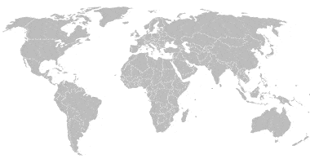
An example
Moscow
But you don´t do this (server would crash due to too many HTTP requests)

Slide 53
An example
You replicate the information in servers around the different world regions

Slide 54
An example
How do you send the data to the servers?

Slide 55
An example
How do you send the data to the servers?

Slide 56
An example
You calculate the minimum spanning tree

Slide 57
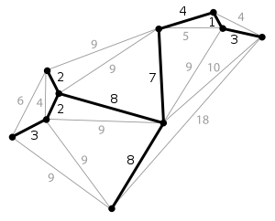
Definition
Minimum Spanning Tree (MST)
The tree that includes all vertices of undirected graph G using the subset of edges with minimum total weight.
If G has |V| vertices, the MST has:
|V| vertices
|V|-1 edges
https://en.wikipedia.org/wiki/Minimum_spanning_tree

Slide 58
Small example
Graph G
J
2
K
1
6
N
10
L
8
M
4
One spanning tree (Total weight: 22)
J
2
K
1
Minimum spanning tree (Total weight: 15)
N
J
2
K
10
6
1
L
8
M
4
6
N
10
L
8
M
4

Slide 59
Algorithms to find the MST: Prim’s & Kruskal’s

Slide 60

Prim’s Algorithm
A
2
B
3
C
10
15
11
6
12
D
8
E
5
F
1
5
17
7
10
G
4
H
9
I
Prim’s algorithm (also known as Jarník-Prim. 1930, 1957)

Slide 61
Prim’s Algorithm
A
2
B
3
C
10
15
11
6
12
D
8
E
5
F
1
5
17
7
10
G
4
H
9
I
Prim’s algorithm (also known as Jarník-Prim. 1930, 1957)

Slide 62
Prim’s Algorithm
A
2
B
3
C
10
15
11
6
12
D
8
E
5
F
1
5
17
7
10
G
4
H
9
I
Prim’s algorithm (also known as Jarník-Prim. 1930, 1957)

Slide 63
Prim’s Algorithm
A
2
B
3
C
10
15
11
6
12
D
8
E
5
F
1
5
17
7
10
G
4
H
9
I
Prim’s algorithm (also known as Jarník-Prim. 1930, 1957)

Slide 64
Prim’s Algorithm
A
2
B
3
C
10
15
11
6
12
D
8
E
5
F
1
5
17
7
10
G
4
H
9
I
Prim’s algorithm (also known as Jarník-Prim. 1930, 1957)

Slide 65
Prim’s Algorithm
A
2
B
3
C
10
15
11
6
12
D
8
E
5
F
1
5
17
7
10
G
4
H
9
I
Prim’s algorithm (also known as Jarník-Prim. 1930, 1957)

Slide 66
Prim’s Algorithm
A
2
B
3
C
10
15
11
6
12
D
8
E
5
F
1
5
17
7
10
G
4
H
9
I
Prim’s algorithm (also known as Jarník-Prim. 1930, 1957)

Slide 67
Prim’s Algorithm
A
2
B
3
C
10
15
11
6
12
D
8
E
5
F
1
5
17
7
10
G
4
H
9
I
Prim’s algorithm (also known as Jarník-Prim. 1930, 1957)

Slide 68
Prim’s Algorithm
A
2
B
3
C
10
15
11
6
12
D
8
E
5
F
1
5
17
7
10
G
4
H
9
I
Prim’s algorithm (also known as Jarník-Prim. 1930, 1957)

Slide 69
Prim’s Algorithm
Initialise the spanning tree with one vertex from graph G
While (there are still vertices to add)
find the set of links L connecting one node in the tree with a node not in the tree
Find, in L, the edge with minimum weight
add that edge, and the new vertex, to the spanning tree
Prim’s algorithm (also known as Jarník-Prim. 1930, 1957)

Slide 70
Prim’s Algorithm
vs <- vertices(G)
T <- new Graph(FIRST(vs), {})
Initialise the spanning tree with one vertex from graph G
While (there are still vertices to add)
find the set of links L connecting one node in the tree with a node not in the tree
Find, in L, the edge with minimum weight
add that edge, and the new vertex, to the spanning tree
Prim’s algorithm (also known as Jarník-Prim. 1930, 1957)

Slide 71
Prim’s Algorithm
vs <- vertices(G)
T <- new Graph(FIRST(vs), {})
Initialise the spanning tree with one vertex from graph G
While (there are still vertices to add)
find the set of links L connecting one node in the tree with a node not in the tree
Find, in L, the edge with minimum weight
add that edge, and the new vertex, to the spanning tree
while ( |T| < |G|)
Prim’s algorithm (also known as Jarník-Prim. 1930, 1957)

Slide 72
Prim’s Algorithm
vs <- vertices(G)
T <- new Graph(FIRST(vs), {})
Initialise the spanning tree with one vertex from graph G
While (there are still vertices to add)
find the set of links L connecting one node in the tree with a node not in the tree
Find, in L, the edge with minimum weight
add that edge, and the new vertex, to the spanning tree
while ( |T| < |G|)
L <- {e| e ∈ edges(G) ^ FROM(e) ∈ T ^ TO(e) ∈ G}
Prim’s algorithm (also known as Jarník-Prim. 1930, 1957)

Slide 73
Prim’s Algorithm
vs <- vertices(G)
T <- new Graph(FIRST(vs), {})
Initialise the spanning tree with one vertex from graph G
While (there are still vertices to add)
find the set of links L connecting one node in the tree with a node not in the tree
Find, in L, the edge with minimum weight
add that edge, and the new vertex, to the spanning tree
while ( |T| < |G|)
L <- {e| e ∈ edges(G) ^ FROM(e) ∈ T ^ TO(e) ∈ G}
newE <- min_{e∈L} weight(e)
Prim’s algorithm (also known as Jarník-Prim. 1930, 1957)

Slide 74
Prim’s Algorithm
vs <- vertices(G)
T <- new Graph(FIRST(vs), {})
Initialise the spanning tree with one vertex from graph G
While (there are still vertices to add)
find the set of links L connecting one node in the tree with a node not in the tree
Find, in L, the edge with minimum weight
add that edge, and the new vertex, to the spanning tree
while ( |T| < |G|)
L <- {e| e ∈ edges(G) ^ FROM(e) ∈ T ^ TO(e) ∈ G}
newE <- min_{e∈L} weight(e)
addVertex(T,TO(e))
addEdge(T,newE)
Prim’s algorithm (also known as Jarník-Prim. 1930, 1957)

Slide 75
Prim’s Algorithm
function PRIM_MST
vs <- vertices(G)
T <- new Graph(FIRST(vs), {})
while ( |T| < |G|)
L <- {e| e ∈ edges(G) ^ FROM(e) ∈ T ^ TO(e) ∈ G}
newE <- min_{e∈L} weight(e)
addVertex(T,TO(e))
addEdge(T,newE)
end while
end function
Prim’s algorithm (also known as Jarník-Prim. 1930, 1957)

Slide 76
Prim’s Algorithm
function PRIM_MST
vs <- vertices(G)
T <- new Graph(FIRST(vs), {})
while ( |T| < |G|)
L <- {e| e ∈ edges(G) ^ FROM(e) ∈ T ^ TO(e) ∈ G}
newE <- min_{e∈L} weight(e)
addVertex(T,TO(e))
addEdge(T,newE)
end while
end function
1. Initialise the spanning tree T with one vertex from graph G
Prim’s algorithm (also known as Jarník-Prim. 1930, 1957)

Slide 77
Prim’s Algorithm
function PRIM_MST
vs <- vertices(G)
T <- new Graph(FIRST(vs), {})
while ( |T| < |G|)
L <- {e| e ∈ edges(G) ^ FROM(e) ∈ T ^ TO(e) ∈ G}
newE <- min_{e∈L} weight(e)
addVertex(T,TO(e))
addEdge(T,newE)
end while
end function
1. Initialise the spanning tree T with one vertex from graph G
2. While (there are still vertices to add)
Prim’s algorithm (also known as Jarník-Prim. 1930, 1957)

Slide 78
Prim’s Algorithm
function PRIM_MST
vs <- vertices(G)
T <- new Graph(FIRST(vs), {})
while ( |T| < |G|)
L <- {e| e ∈ edges(G) ^ FROM(e) ∈ T ^ TO(e) ∈ G}
newE <- min_{e∈L} weight(e)
addVertex(T,TO(e))
addEdge(T,newE)
end while
end function
1. Initialise the spanning tree T with one vertex from graph G
2. While (there are still vertices to add)
find set L (links connecting one node in the tree with a node not in the tree)
Prim’s algorithm (also known as Jarník-Prim. 1930, 1957)

Slide 79
Prim’s Algorithm
function PRIM_MST
vs <- vertices(G)
T <- new Graph(FIRST(vs), {})
while ( |T| < |G|)
L <- {e| e ∈ edges(G) ^ FROM(e) ∈ T ^ TO(e) ∈ G}
newE <- min_{e∈L} weight(e)
addVertex(T,TO(e))
addEdge(T,newE)
end while
end function
1. Initialise the spanning tree T with one vertex from graph G
2. While (there are still vertices to add)
find set L (links connecting one node in the tree with a node not in the tree)
find minimum weight edge in L
Prim’s algorithm (also known as Jarník-Prim. 1930, 1957)

Slide 80
Prim’s Algorithm
function PRIM_MST
vs <- vertices(G)
T <- new Graph(FIRST(vs), {})
while ( |T| < |G|)
L <- {e| e ∈ edges(G) ^ FROM(e) ∈ T ^ TO(e) ∈ G}
newE <- min_{e∈L} weight(e)
addVertex(T,TO(e))
addEdge(T,newE)
end while
end function
1. Initialise the spanning tree T with one vertex from graph G
2. While (there are still vertices to add)
find set L (links connecting one node in the tree with a node not in the tree)
find minimum weight edge in L
add minimum weight edge, and its vertex, to T
Prim’s algorithm (also known as Jarník-Prim. 1930, 1957)

Slide 81
Prim’s Algorithm
function PRIM_MST
vs <- vertices(G)
T <- new Graph(FIRST(vs), {})
while ( |T| < |G|)
L <- {e| e ∈ edges(G) ^ FROM(e) ∈ T ^ TO(e) ∈ G}
newE <- min_{e∈L} weight(e)
addVertex(T,TO(e))
addEdge(T,newE)
end while
end function
2
G
J
K
1
6
N
10
L
8
M
4
Prim’s algorithm (also known as Jarník-Prim. 1930, 1957)

Slide 82
Prim’s Algorithm
function PRIM_MST
vs <- vertices(G)
T <- new Graph(FIRST(vs), {})
while ( |T| < |G|)
L <- {e| e ∈ edges(G) ^ FROM(e) ∈ T ^ TO(e) ∈ G}
newE <- min_{e∈L} weight(e)
addVertex(T,TO(e))
addEdge(T,newE)
end while
end function
vs={J,K,L,M,N}
2
G
J
K
1
6
N
10
L
8
M
4
Prim’s algorithm (also known as Jarník-Prim. 1930, 1957)

Slide 83
Prim’s Algorithm
function PRIM_MST
vs <- vertices(G)
T <- new Graph(FIRST(vs), {})
while ( |T| < |G|)
L <- {e| e ∈ edges(G) ^ FROM(e) ∈ T ^ TO(e) ∈ G}
newE <- min_{e∈L} weight(e)
addVertex(T,TO(e))
addEdge(T,newE)
end while
end function
vs={J,K,L,M,N}
2
G
T
J
K
1
J
6
N
10
L
8
M
4
Prim’s algorithm (also known as Jarník-Prim. 1930, 1957)

Slide 84
Prim’s Algorithm
function PRIM_MST
vs <- vertices(G)
T <- new Graph(FIRST(vs), {})
while ( |T| < |G|)
L <- {e| e ∈ edges(G) ^ FROM(e) ∈ T ^ TO(e) ∈ G}
newE <- min_{e∈L} weight(e)
addVertex(T,TO(e))
addEdge(T,newE)
end while
end function
vs={J,K,L,M,N}
2
G
T
J
K
1
J
6
N
10
L
8
M
4
Prim’s algorithm (also known as Jarník-Prim. 1930, 1957)

Slide 85
Prim’s Algorithm
function PRIM_MST
vs <- vertices(G)
T <- new Graph(FIRST(vs), {})
while ( |T| < |G|)
L <- {e| e ∈ edges(G) ^ FROM(e) ∈ T ^ TO(e) ∈ G}
newE <- min_{e∈L} weight(e)
addVertex(T,TO(e))
addEdge(T,newE)
end while
end function
vs={J,K,L,M,N}
L={((J,K,2), (J,L,10)}
2
G
T
J
K
1
J
6
N
10
L
8
M
4
Prim’s algorithm (also known as Jarník-Prim. 1930, 1957)

Slide 86
Prim’s Algorithm
function PRIM_MST
vs <- vertices(G)
T <- new Graph(FIRST(vs), {})
while ( |T| < |G|)
L <- {e| e ∈ edges(G) ^ FROM(e) ∈ T ^ TO(e) ∈ G}
newE <- min_{e∈L} weight(e)
addVertex(T,TO(e))
addEdge(T,newE)
end while
end function
vs={J,K,L,M,N}
L={((J,K,2), (J,L,10)}
newE=(J,K,2)
2
G
T
J
K
1
J
6
N
10
L
8
M
4
Prim’s algorithm (also known as Jarník-Prim. 1930, 1957)

Slide 87
Prim’s Algorithm
function PRIM_MST
vs <- vertices(G)
T <- new Graph(FIRST(vs), {})
while ( |T| < |G|)
L <- {e| e ∈ edges(G) ^ FROM(e) ∈ T ^ TO(e) ∈ G}
newE <- min_{e∈L} weight(e)
addVertex(T,TO(e))
addEdge(T,newE)
end while
end function
vs={J,K,L,M,N}
L={((J,K,2), (J,L,10)}
newE=(J,K,2)
2
G
T
J
K
1
J
K
6
N
10
L
8
M
4
Prim’s algorithm (also known as Jarník-Prim. 1930, 1957)

Slide 88
Prim’s Algorithm
function PRIM_MST
vs <- vertices(G)
T <- new Graph(FIRST(vs), {})
while ( |T| < |G|)
L <- {e| e ∈ edges(G) ^ FROM(e) ∈ T ^ TO(e) ∈ G}
newE <- min_{e∈L} weight(e)
addVertex(T,TO(e))
addEdge(T,newE)
end while
end function
vs={J,K,L,M,N}
L={((J,K,2), (J,L,10)}
newE=(J,K,2)
2
G
T
2
J
K
1
J
K
6
N
10
L
8
M
4
Prim’s algorithm (also known as Jarník-Prim. 1930, 1957)

Slide 89
Prim’s Algorithm
function PRIM_MST
vs <- vertices(G)
T <- new Graph(FIRST(vs), {})
while ( |T| < |G|)
L <- {e| e ∈ edges(G) ^ FROM(e) ∈ T ^ TO(e) ∈ G}
newE <- min_{e∈L} weight(e)
addVertex(T,TO(e))
addEdge(T,newE)
end while
end function
vs={J,K,L,M,N}
L={((J,K,2), (J,L,10)}
newE=(J,K,2)
2
G
T
2
J
K
1
J
K
6
N
10
L
8
M
4
Prim’s algorithm (also known as Jarník-Prim. 1930, 1957)

Slide 90
Prim’s Algorithm
function PRIM_MST
vs <- vertices(G)
T <- new Graph(FIRST(vs), {})
while ( |T| < |G|)
L <- {e| e ∈ edges(G) ^ FROM(e) ∈ T ^ TO(e) ∈ G}
newE <- min_{e∈L} weight(e)
addVertex(T,TO(e))
addEdge(T,newE)
end while
end function
vs={J,K,L,M,N}
L={(J,L,10),(K,M,6),(K,N,1)}
newE=(J,K,2)
2
G
T
2
J
K
1
J
K
6
N
10
L
8
M
4
Prim’s algorithm (also known as Jarník-Prim. 1930, 1957)

Slide 91
Prim’s Algorithm
function PRIM_MST
vs <- vertices(G)
T <- new Graph(FIRST(vs), {})
while ( |T| < |G|)
L <- {e| e ∈ edges(G) ^ FROM(e) ∈ T ^ TO(e) ∈ G}
newE <- min_{e∈L} weight(e)
addVertex(T,TO(e))
addEdge(T,newE)
end while
end function
vs={J,K,L,M,N}
L={(J,L,10),(K,M,6),(K,N,1)}
newE=(K,N,1)
2
G
T
2
J
K
1
J
K
6
N
10
L
8
M
4
Prim’s algorithm (also known as Jarník-Prim. 1930, 1957)

Slide 92
Prim’s Algorithm
function PRIM_MST
vs <- vertices(G)
T <- new Graph(FIRST(vs), {})
while ( |T| < |G|)
L <- {e| e ∈ edges(G) ^ FROM(e) ∈ T ^ TO(e) ∈ G}
newE <- min_{e∈L} weight(e)
addVertex(T,TO(e))
addEdge(T,newE)
end while
end function
vs={J,K,L,M,N}
L={(J,L,10),(K,M,6),(K,N,1)}
newE=(K,N,1)
2
G
T
2
J
K
1
J
K
6
N
N
10
L
8
M
4
Prim’s algorithm (also known as Jarník-Prim. 1930, 1957)

Slide 93
Prim’s Algorithm
function PRIM_MST
vs <- vertices(G)
T <- new Graph(FIRST(vs), {})
while ( |T| < |G|)
L <- {e| e ∈ edges(G) ^ FROM(e) ∈ T ^ TO(e) ∈ G}
newE <- min_{e∈L} weight(e)
addVertex(T,TO(e))
addEdge(T,newE)
end while
end function
vs={J,K,L,M,N}
L={(J,L,10),(K,M,6),(K,N,1)}
newE=(K,N,1)
2
G
T
2
J
K
1
J
K
1
6
N
N
10
L
8
M
4
Prim’s algorithm (also known as Jarník-Prim. 1930, 1957)

Slide 94
Prim’s Algorithm
function PRIM_MST
vs <- vertices(G)
T <- new Graph(FIRST(vs), {})
while ( |T| < |G|)
L <- {e| e ∈ edges(G) ^ FROM(e) ∈ T ^ TO(e) ∈ G}
newE <- min_{e∈L} weight(e)
addVertex(T,TO(e))
addEdge(T,newE)
end while
end function
vs={J,K,L,M,N}
L={(J,L,10),(K,M,6),(K,N,1)}
newE=(K,N,1)
2
G
T
2
J
K
1
J
K
1
6
N
N
10
L
8
M
4
Prim’s algorithm (also known as Jarník-Prim. 1930, 1957)

Slide 95
Prim’s Algorithm
function PRIM_MST
vs <- vertices(G)
T <- new Graph(FIRST(vs), {})
while ( |T| < |G|)
L <- {e| e ∈ edges(G) ^ FROM(e) ∈ T ^ TO(e) ∈ G}
newE <- min_{e∈L} weight(e)
addVertex(T,TO(e))
addEdge(T,newE)
end while
end function
vs={J,K,L,M,N}
L={(J,L,10),(K,M,6),(N,M,4)}
newE=(K,N,1)
2
G
T
2
J
K
1
J
K
1
6
N
N
10
L
8
M
4
Prim’s algorithm (also known as Jarník-Prim. 1930, 1957)

Slide 96
Prim’s Algorithm
function PRIM_MST
vs <- vertices(G)
T <- new Graph(FIRST(vs), {})
while ( |T| < |G|)
L <- {e| e ∈ edges(G) ^ FROM(e) ∈ T ^ TO(e) ∈ G}
newE <- min_{e∈L} weight(e)
addVertex(T,TO(e))
addEdge(T,newE)
end while
end function
vs={J,K,L,M,N}
L={(J,L,10),(K,M,6),(N,M,4)}
newE=(M,N,4)
2
G
T
2
J
K
1
J
K
1
6
N
N
10
L
8
M
4
Prim’s algorithm (also known as Jarník-Prim. 1930, 1957)

Slide 97
Prim’s Algorithm
function PRIM_MST
vs <- vertices(G)
T <- new Graph(FIRST(vs), {})
while ( |T| < |G|)
L <- {e| e ∈ edges(G) ^ FROM(e) ∈ T ^ TO(e) ∈ G}
newE <- min_{e∈L} weight(e)
addVertex(T,TO(e))
addEdge(T,newE)
end while
end function
vs={J,K,L,M,N}
L={(J,L,10),(K,M,6),(N,M,4)}
newE=(M,N,4)
2
G
T
2
J
K
1
J
K
1
6
N
N
10
L
8
M
4
M
Prim’s algorithm (also known as Jarník-Prim. 1930, 1957)

Slide 98
Prim’s Algorithm
function PRIM_MST
vs <- vertices(G)
T <- new Graph(FIRST(vs), {})
while ( |T| < |G|)
L <- {e| e ∈ edges(G) ^ FROM(e) ∈ T ^ TO(e) ∈ G}
newE <- min_{e∈L} weight(e)
addVertex(T,TO(e))
addEdge(T,newE)
end while
end function
vs={J,K,L,M,N}
L={(J,L,10),(K,M,6),(N,M,4)}
newE=(M,N,4)
2
G
T
2
J
K
1
J
K
1
6
N
N
10
L
8
M
4
M
4
Prim’s algorithm (also known as Jarník-Prim. 1930, 1957)

Slide 99
Prim’s Algorithm
function PRIM_MST
vs <- vertices(G)
T <- new Graph(FIRST(vs), {})
while ( |T| < |G|)
L <- {e| e ∈ edges(G) ^ FROM(e) ∈ T ^ TO(e) ∈ G}
newE <- min_{e∈L} weight(e)
addVertex(T,TO(e))
addEdge(T,newE)
end while
end function
vs={J,K,L,M,N}
L={(J,L,10),(K,M,6),(N,M,4)}
newE=(M,N,4)
2
G
T
2
J
K
1
J
K
1
6
N
N
10
L
8
M
4
M
4
Prim’s algorithm (also known as Jarník-Prim. 1930, 1957)

Slide 100
Prim’s Algorithm
function PRIM_MST
vs <- vertices(G)
T <- new Graph(FIRST(vs), {})
while ( |T| < |G|)
L <- {e| e ∈ edges(G) ^ FROM(e) ∈ T ^ TO(e) ∈ G}
newE <- min_{e∈L} weight(e)
addVertex(T,TO(e))
addEdge(T,newE)
end while
end function
vs={J,K,L,M,N}
L={(J,L,10),(M,L,8)}
newE=(M,N,4)
2
G
T
2
J
K
1
J
K
1
6
N
N
10
L
8
M
4
M
4
Prim’s algorithm (also known as Jarník-Prim. 1930, 1957)

Slide 101
Prim’s Algorithm
function PRIM_MST
vs <- vertices(G)
T <- new Graph(FIRST(vs), {})
while ( |T| < |G|)
L <- {e| e ∈ edges(G) ^ FROM(e) ∈ T ^ TO(e) ∈ G}
newE <- min_{e∈L} weight(e)
addVertex(T,TO(e))
addEdge(T,newE)
end while
end function
vs={J,K,L,M,N}
L={(J,L,10),(M,L,8)}
newE=(M,L,8)
2
G
T
2
J
K
1
J
K
1
6
N
N
10
L
8
M
4
L
M
4
Prim’s algorithm (also known as Jarník-Prim. 1930, 1957)

Slide 102
Prim’s Algorithm
function PRIM_MST
vs <- vertices(G)
T <- new Graph(FIRST(vs), {})
while ( |T| < |G|)
L <- {e| e ∈ edges(G) ^ FROM(e) ∈ T ^ TO(e) ∈ G}
newE <- min_{e∈L} weight(e)
addVertex(T,TO(e))
addEdge(T,newE)
end while
end function
vs={J,K,L,M,N}
L={(J,L,10),(M,L,8)}
newE=(M,L,8)
2
G
T
2
J
K
1
J
K
1
6
N
N
10
L
8
M
4
L
8
M
4
Prim’s algorithm (also known as Jarník-Prim. 1930, 1957)

Slide 103
Prim’s Algorithm
function PRIM_MST
vs <- vertices(G)
T <- new Graph(FIRST(vs), {})
while ( |T| < |G|)
L <- {e| e ∈ edges(G) ^ FROM(e) ∈ T ^ TO(e) ∈ G}
newE <- min_{e∈L} weight(e)
addVertex(T,TO(e))
addEdge(T,newE)
end while
end function
vs={J,K,L,M,N}
L={(J,L,10),(M,L,8)}
newE=(M,L,8)
2
G
T
2
J
K
1
J
K
1
6
N
N
10
L
8
M
4
L
8
M
4
Prim’s algorithm (also known as Jarník-Prim. 1930, 1957)

Slide 104
Prim’s Algorithm
function PRIM_MST
vs <- vertices(G)
T <- new Graph(FIRST(vs), {})
while ( |T| < |G|)
L <- {e| e ∈ edges(G) ^ FROM(e) ∈ T ^ TO(e) ∈ G}
newE <- min_{e∈L} weight(e)
addVertex(T,TO(e))
addEdge(T,newE)
end while
end function
vs={J,K,L,M,N}
L={(J,L,10),(M,L,8)}
newE=(M,L,8)
2
G
T
2
J
K
1
J
K
1
6
N
N
10
L
8
M
4
L
8
M
4
Prim’s algorithm (also known as Jarník-Prim. 1930, 1957)

Slide 105
Prim’s Algorithm
function PRIM_MST
vs <- vertices(G)
T <- new Graph(FIRST(vs), {})
while ( |T| < |G|)
L <- {e| e ∈ edges(G) ^ FROM(e) ∈ T ^ TO(e) ∈ G}
newE <- min_{e∈L} weight(e)
addVertex(T,TO(e))
addEdge(T,newE)
end while
end function
vs={J,K,L,M,N}
L={(J,L,10),(M,L,8)}
newE=(M,L,8)
2
G
T
2
J
K
1
J
K
1
6
N
N
10
L
8
M
4
L
8
M
4
Prim’s algorithm (also known as Jarník-Prim. 1930, 1957)

Slide 106
Prim’s Algorithm
function PRIM_MST
vs <- vertices(G)
T <- new Graph(FIRST(vs), {})
while ( |T| < |G|)
L <- {e| e ∈ edges(G) ^ FROM(e) ∈ T ^ TO(e) ∈ G}
newE <- min_{e∈L} weight(e)
addVertex(T,TO(e))
addEdge(T,newE)
end while
end function
Prim’s algorithm (also known as Jarník-Prim. 1930, 1957)

Slide 107
Prim’s Algorithm
function PRIM_MST
vs <- vertices(G)
T <- new Graph(FIRST(vs), {})
while ( |T| < |G|)
L <- {e| e ∈ edges(G) ^ FROM(e) ∈ T ^ TO(e) ∈ G}
newE <- min_{e∈L} weight(e)
addVertex(T,TO(e))
addEdge(T,newE)
end while
end function
w<-∞
for e ∈ edges(G) ^ FROM(e) ∈ T ^ TO(e) ∈ G
if weight(e)<w then
w<-weight(e)
newE<-e
newVertex<-TO(e)
end if
end for
Prim’s algorithm (also known as Jarník-Prim. 1930, 1957)

Slide 108
Quick learning check
G
A
5
B
2
C
6
1
7
9
4
D
8
E
3
F
15
16
10
17
What is the cost of the MST of G?

Slide 109
Quick learning check
G
A
5
B
2
C
6
1
7
9
4
D
8
E
3
F
MST
A
B
2
C
6
1
4
Cost:16
D
E
3
F
What is the cost of the MST of G?

Slide 110
Kruskal’s Algorithm
G
FOREST: A disjoint union of tress
H
I
J
A
B
C
K
L
D
E
F
M

Slide 111
Kruskal’s Algorithm
A
2
B
3
C
10
15
11
6
12
D
8
E
5
F
1
5
17
7
10
G
4
H
9
I

Slide 112
Kruskal’s Algorithm
A
2
B
3
C
10
15
11
6
12
D
8
E
5
F
1
5
17
7
10
G
4
H
9
I
Kruskal’s algorithms starts with N forests (of 1-node tree each)

Slide 113
Kruskal’s Algorithm
A
2
B
3
C
10
15
11
6
12
D
8
E
5
F
1
5
17
7
10
G
4
H
9
I
5 min to: think of a rule for the next edge(s) to add

Slide 114
Kruskal’s Algorithm
A
2
B
3
C
10
15
11
6
12
D
8
E
5
F
5
17
1
7
10
G
4
H
9
I

Slide 115
Kruskal’s Algorithm
A
2
B
3
C
10
15
11
6
12
D
8
E
5
F
1
5
17
7
10
G
4
H
9
I

Slide 116
Kruskal’s Algorithm
A
2
B
3
C
10
15
11
6
12
D
8
E
5
F
1
5
17
7
10
G
4
H
9
I

Slide 117
Kruskal’s Algorithm
A
2
B
3
C
10
15
11
6
12
D
8
E
5
F
1
5
17
7
10
G
4
H
9
I

Slide 118
Kruskal’s Algorithm
A
2
B
3
C
10
15
11
6
12
D
8
E
5
F
1
5
17
7
10
G
4
H
9
I

Slide 119
Kruskal’s Algorithm
A
2
B
3
C
10
15
11
6
12
D
8
E
5
F
1
5
17
7
10
G
4
H
9
I
Although (D,H,5) is the next lowest cost edge, it is not included it because it does not connect two different forests

Slide 120
Kruskal’s Algorithm
A
2
B
3
C
10
15
11
6
12
D
8
E
5
F
1
5
17
7
10
G
4
H
9
I

Slide 121
Kruskal’s Algorithm
A
2
B
3
C
10
15
11
6
12
D
8
E
5
F
1
5
17
7
10
G
4
H
9
I

Slide 122
Kruskal’s Algorithm
A
2
B
3
C
10
15
11
6
12
D
8
E
5
F
1
5
17
7
10
G
4
H
9
I

Slide 123
Kruskal’s Algorithm
Initialise the spanning tree with N forests of 1-node tree each
Sort edges in increasing order by weight w
For each edge in ordered set:
Add edge if it joins two different forests
Join these forests in a single one

Slide 124
Kruskal’s Algorithm
vs <- vertices(G)
T <- new Graph(vs, {})
F<- new DisjointSet()
for v ∈ vs do
MAKE-SET(F,v)
end for
Initialise the spanning tree with N forests of 1-node tree each
Sort edges in increasing order by weight w
For each edge in ordered set:
Add edge if it joins two different forests
Join these forests in a single one

Slide 125
Kruskal’s Algorithm
vs <- vertices(G)
T <- new Graph(vs, {})
F<- new DisjointSet()
for v ∈ vs do
MAKE-SET(F,v)
end for
This part creates a set of forests
(we need to keep track of them)
Initialise the spanning tree with N forests of 1-node tree each
Sort edges in increasing order by weight w
For each edge in ordered set:
Add edge if it joins two different forests
Join these forests in a single one

Slide 126
Kruskal’s Algorithm
vs <- vertices(G)
T <- new Graph(vs, {})
F<- new DisjointSet()
for v ∈ vs do
MAKE-SET(F,v)
end for
Initialise the spanning tree with N forests of 1-node tree each
Sort edges in increasing order by weight w
For each edge in ordered set:
Add edge if it joins two different forests
Join these forests in a single one
L<- sort(edges(G))

Slide 127
Kruskal’s Algorithm
vs <- vertices(G)
T <- new Graph(vs, {})
F<- new DisjointSet()
for v ∈ vs do
MAKE-SET(F,v)
end for
Initialise the spanning tree with N forests of 1-node tree each
Sort edges in increasing order by weight w
For each edge in ordered set:
Add edge if it joins two different forests
Join these forests in a single one
L<- sort(edges(G))
for e ∈ L do
if FIND(F,FROM(e)) ≠ FIND(F,TO(e)) then
addEdge(T,e)
UNION(F,e)
end if
end for

Slide 128
Kruskal’s Algorithm
vs <- vertices(G)
T <- new Graph(vs, {})
F<- new DisjointSet()
for v ∈ vs do
MAKE-SET(F,v)
end for
Initialise the spanning tree with N forests of 1-node tree each
Sort edges in increasing order by weight w
For each edge in ordered set:
Add edge if it joins two different forests
Join these forests in a single one
L<- sort(edges(G))
for e ∈ L do
if FIND(F,FROM(e)) ≠ FIND(F,TO(e)) then
addEdge(T,e)
UNION(F,e)
end if
end for
If edge belongs to different forests

Slide 129
Kruskal’s Algorithm
vs <- vertices(G)
T <- new Graph(vs, {})
F<- new DisjointSet()
for v ∈ vs do
MAKE-SET(F,v)
end for
Initialise the spanning tree with N forests of 1-node tree each
Sort edges in increasing order by weight w
For each edge in ordered set:
Add edge if it joins two different forests
Join these forests in a single one
L<- sort(edges(G))
for e ∈ L do
if FIND(F,FROM(e)) ≠ FIND(F,TO(e)) then
addEdge(T,e)
UNION(F,e)
end if
end for
Join forests

Slide 130
Kruskal’s Algorithm
function KRUSKAL_MST(G)
vs <- vertices(G)
T <- new Graph(vs, {})
F<- new DisjointSet()
for v ∈ vs do
MAKE-SET(F,v)
end for
L<- sort(edges(G))
for e ∈ L do
if FIND(F,FROM(e)) ≠ FIND(F,TO(e)) then
addEdge(T,e)
UNION(F,e)
end if
end for
end function
J
2
K
G
1
6
N
10
L
8
M
4

Slide 131
Kruskal’s Algorithm
function KRUSKAL_MST(G)
vs <- vertices(G)
T <- new Graph(vs, {})
F<- new DisjointSet()
for v ∈ vs do
MAKE-SET(F,v)
end for
L<- sort(edges(G))
for e ∈ L do
if FIND(F,FROM(e)) ≠ FIND(F,TO(e)) then
addEdge(T,e)
UNION(F,e)
end if
end for
end function
vs={J,K,L,M,N}
J
2
K
G
1
6
N
10
L
8
M
4

Slide 132
Kruskal’s Algorithm
function KRUSKAL_MST(G)
vs <- vertices(G)
T <- new Graph(vs, {})
F<- new DisjointSet()
for v ∈ vs do
MAKE-SET(F,v)
end for
L<- sort(edges(G))
for e ∈ L do
if FIND(F,FROM(e)) ≠ FIND(F,TO(e)) then
addEdge(T,e)
UNION(F,e)
end if
end for
end function
vs={J,K,L,M,N}
2
T
J
K
G
J
K
1
6
N
N
10
L
8
M
4
L
M

Slide 133
Kruskal’s Algorithm
function KRUSKAL_MST(G)
vs <- vertices(G)
T <- new Graph(vs, {})
F<- new DisjointSet()
for v ∈ vs do
MAKE-SET(F,v)
end for
L<- sort(edges(G))
for e ∈ L do
if FIND(F,FROM(e)) ≠ FIND(F,TO(e)) then
addEdge(T,e)
UNION(F,e)
end if
end for
end function
vs={J,K,L,M,N}
F={}
2
T
J
K
G
J
K
1
6
N
N
10
L
8
M
4
L
M

Slide 134
Kruskal’s Algorithm
function KRUSKAL_MST(G)
vs <- vertices(G)
T <- new Graph(vs, {})
F<- new DisjointSet()
for v ∈ vs do
MAKE-SET(F,v)
end for
L<- sort(edges(G))
for e ∈ L do
if FIND(F,FROM(e)) ≠ FIND(F,TO(e)) then
addEdge(T,e)
UNION(F,e)
end if
end for
end function
vs={J,K,L,M,N}
F={}
F={ {J},{K},{L},{M},{N} }
2
T
J
K
G
J
K
1
6
N
N
10
L
8
M
4
L
M

Slide 135
Kruskal’s Algorithm
function KRUSKAL_MST(G)
vs <- vertices(G)
T <- new Graph(vs, {})
F<- new DisjointSet()
for v ∈ vs do
MAKE-SET(F,v)
end for
L<- sort(edges(G))
for e ∈ L do
if FIND(F,FROM(e)) ≠ FIND(F,TO(e)) then
addEdge(T,e)
UNION(F,e)
end if
end for
end function
vs={J,K,L,M,N}
F={}
F={ {J},{K},{L},{M},{N} }
L={(K,N,1),(J,K,2),(M,N,4),(K,M,6),(L,M,8),(J,L,10) }
2
T
J
K
G
J
K
1
6
N
N
10
L
8
M
4
L
M

Slide 136
Kruskal’s Algorithm
function KRUSKAL_MST(G)
vs <- vertices(G)
T <- new Graph(vs, {})
F<- new DisjointSet()
for v ∈ vs do
MAKE-SET(F,v)
end for
L<- sort(edges(G))
for e ∈ L do
if FIND(F,FROM(e)) ≠ FIND(F,TO(e)) then
addEdge(T,e)
UNION(F,e)
end if
end for
end function
vs={J,K,L,M,N}
F={}
F={ {J},{K},{L},{M},{N} }
L={(K,N,1),(J,K,2),(M,N,4),(K,M,6),(L,M,8),(J,L,10) }
2
T
J
K
G
J
K
1
6
N
N
10
L
8
M
4
L
M

Slide 137
Kruskal’s Algorithm
function KRUSKAL_MST(G)
vs <- vertices(G)
T <- new Graph(vs, {})
F<- new DisjointSet()
for v ∈ vs do
MAKE-SET(F,v)
end for
L<- sort(edges(G))
for e ∈ L do
if FIND(F,FROM(e)) ≠ FIND(F,TO(e)) then
addEdge(T,e)
UNION(F,e)
end if
end for
end function
vs={J,K,L,M,N}
F={}
F={ {J},{K},{L},{M},{N} }
L={(K,N,1),(J,K,2),(M,N,4),(K,M,6),(L,M,8),(J,L,10) }
2
T
J
K
G
J
K
1
6
N
N
10
L
8
M
4
L
M

Slide 138
Kruskal’s Algorithm
function KRUSKAL_MST(G)
vs <- vertices(G)
T <- new Graph(vs, {})
F<- new DisjointSet()
for v ∈ vs do
MAKE-SET(F,v)
end for
L<- sort(edges(G))
for e ∈ L do
if FIND(F,FROM(e)) ≠ FIND(F,TO(e)) then
addEdge(T,e)
UNION(F,e)
end if
end for
end function
vs={J,K,L,M,N}
F={}
F={ {J},{K},{L},{M},{N} }
L={(K,N,1),(J,K,2),(M,N,4),(K,M,6),(L,M,8),(J,L,10) }
2
T
J
K
G
J
K
1
1
6
N
N
10
L
8
M
4
L
M

Slide 139
Kruskal’s Algorithm
function KRUSKAL_MST(G)
vs <- vertices(G)
T <- new Graph(vs, {})
F<- new DisjointSet()
for v ∈ vs do
MAKE-SET(F,v)
end for
L<- sort(edges(G))
for e ∈ L do
if FIND(F,FROM(e)) ≠ FIND(F,TO(e)) then
addEdge(T,e)
UNION(F,e)
end if
end for
end function
vs={J,K,L,M,N}
F={}
F={ {J},{K,N},{L},{M}}
L={(K,N,1),(J,K,2),(M,N,4),(K,M,6),(L,M,8),(J,L,10) }
2
T
J
K
G
J
K
1
1
6
N
N
10
L
8
M
4
L
M

Slide 140
Kruskal’s Algorithm
function KRUSKAL_MST(G)
vs <- vertices(G)
T <- new Graph(vs, {})
F<- new DisjointSet()
for v ∈ vs do
MAKE-SET(F,v)
end for
L<- sort(edges(G))
for e ∈ L do
if FIND(F,FROM(e)) ≠ FIND(F,TO(e)) then
addEdge(T,e)
UNION(F,e)
end if
end for
end function
vs={J,K,L,M,N}
F={}
F={ {J},{K,N},{L},{M}}
L={(K,N,1),(J,K,2),(M,N,4),(K,M,6),(L,M,8),(J,L,10) }
2
T
J
K
G
J
K
1
1
6
N
N
10
L
8
M
4
L
M

Slide 141
Kruskal’s Algorithm
function KRUSKAL_MST(G)
vs <- vertices(G)
T <- new Graph(vs, {})
F<- new DisjointSet()
for v ∈ vs do
MAKE-SET(F,v)
end for
L<- sort(edges(G))
for e ∈ L do
if FIND(F,FROM(e)) ≠ FIND(F,TO(e)) then
addEdge(T,e)
UNION(F,e)
end if
end for
end function
vs={J,K,L,M,N}
F={}
F={ {J},{K,N},{L},{M}}
L={(K,N,1),(J,K,2),(M,N,4),(K,M,6),(L,M,8),(J,L,10) }
2
T
J
K
G
J
K
1
1
6
N
N
10
L
8
M
4
L
M

Slide 142
Kruskal’s Algorithm
function KRUSKAL_MST(G)
vs <- vertices(G)
T <- new Graph(vs, {})
F<- new DisjointSet()
for v ∈ vs do
MAKE-SET(F,v)
end for
L<- sort(edges(G))
for e ∈ L do
if FIND(F,FROM(e)) ≠ FIND(F,TO(e)) then
addEdge(T,e)
UNION(F,e)
end if
end for
end function
vs={J,K,L,M,N}
F={}
F={ {J},{K,N},{L},{M}}
L={(K,N,1),(J,K,2),(M,N,4),(K,M,6),(L,M,8),(J,L,10) }
2
T
J
K
G
J
K
1
1
6
N
N
10
L
8
M
4
L
M

Slide 143
Kruskal’s Algorithm
function KRUSKAL_MST(G)
vs <- vertices(G)
T <- new Graph(vs, {})
F<- new DisjointSet()
for v ∈ vs do
MAKE-SET(F,v)
end for
L<- sort(edges(G))
for e ∈ L do
if FIND(F,FROM(e)) ≠ FIND(F,TO(e)) then
addEdge(T,e)
UNION(F,e)
end if
end for
end function
vs={J,K,L,M,N}
F={}
F={ {J,K,N},{L},{M}}
L={(K,N,1),(J,K,2),(M,N,4),(K,M,6),(L,M,8),(J,L,10) }
2
T
J
K
G
J
2
K
1
1
6
N
N
10
L
8
M
4
L
M

Slide 144
Kruskal’s Algorithm
function KRUSKAL_MST(G)
vs <- vertices(G)
T <- new Graph(vs, {})
F<- new DisjointSet()
for v ∈ vs do
MAKE-SET(F,v)
end for
L<- sort(edges(G))
for e ∈ L do
if FIND(F,FROM(e)) ≠ FIND(F,TO(e)) then
addEdge(T,e)
UNION(F,e)
end if
end for
end function
vs={J,K,L,M,N}
F={}
F={ {J,K,N},{L},{M}}
L={(K,N,1),(J,K,2),(M,N,4),(K,M,6),(L,M,8),(J,L,10) }
2
T
J
K
G
J
2
K
1
1
6
N
N
10
L
8
M
4
L
M

Slide 145
Kruskal’s Algorithm
function KRUSKAL_MST(G)
vs <- vertices(G)
T <- new Graph(vs, {})
F<- new DisjointSet()
for v ∈ vs do
MAKE-SET(F,v)
end for
L<- sort(edges(G))
for e ∈ L do
if FIND(F,FROM(e)) ≠ FIND(F,TO(e)) then
addEdge(T,e)
UNION(F,e)
end if
end for
end function
vs={J,K,L,M,N}
F={}
F={ {J,K,N},{L},{M}}
L={(K,N,1),(J,K,2),(M,N,4),(K,M,6),(L,M,8),(J,L,10) }
2
T
J
K
G
J
2
K
1
1
6
N
N
10
L
8
M
4
L
M

Slide 146
Kruskal’s Algorithm
function KRUSKAL_MST(G)
vs <- vertices(G)
T <- new Graph(vs, {})
F<- new DisjointSet()
for v ∈ vs do
MAKE-SET(F,v)
end for
L<- sort(edges(G))
for e ∈ L do
if FIND(F,FROM(e)) ≠ FIND(F,TO(e)) then
addEdge(T,e)
UNION(F,e)
end if
end for
end function
vs={J,K,L,M,N}
F={}
F={ {J,K,N},{L},{M}}
L={(K,N,1),(J,K,2),(M,N,4),(K,M,6),(L,M,8),(J,L,10) }
2
T
J
K
G
J
2
K
1
1
6
N
N
10
L
8
M
4
L
M

Slide 147
Kruskal’s Algorithm
function KRUSKAL_MST(G)
vs <- vertices(G)
T <- new Graph(vs, {})
F<- new DisjointSet()
for v ∈ vs do
MAKE-SET(F,v)
end for
L<- sort(edges(G))
for e ∈ L do
if FIND(F,FROM(e)) ≠ FIND(F,TO(e)) then
addEdge(T,e)
UNION(F,e)
end if
end for
end function
vs={J,K,L,M,N}
F={}
F={ {J,K,N},{L},{M}}
L={(K,N,1),(J,K,2),(M,N,4),(K,M,6),(L,M,8),(J,L,10) }
2
T
J
K
G
J
2
K
1
1
6
N
N
10
L
8
M
4
4
L
M

Slide 148
Kruskal’s Algorithm
function KRUSKAL_MST(G)
vs <- vertices(G)
T <- new Graph(vs, {})
F<- new DisjointSet()
for v ∈ vs do
MAKE-SET(F,v)
end for
L<- sort(edges(G))
for e ∈ L do
if FIND(F,FROM(e)) ≠ FIND(F,TO(e)) then
addEdge(T,e)
UNION(F,e)
end if
end for
end function
vs={J,K,L,M,N}
F={}
F={ {J,K,N,M},{L}}
L={(K,N,1),(J,K,2),(M,N,4),(K,M,6),(L,M,8),(J,L,10) }
2
T
J
K
G
J
2
K
1
1
6
N
N
10
L
8
M
4
4
L
M

Slide 149
Kruskal’s Algorithm
function KRUSKAL_MST(G)
vs <- vertices(G)
T <- new Graph(vs, {})
F<- new DisjointSet()
for v ∈ vs do
MAKE-SET(F,v)
end for
L<- sort(edges(G))
for e ∈ L do
if FIND(F,FROM(e)) ≠ FIND(F,TO(e)) then
addEdge(T,e)
UNION(F,e)
end if
end for
end function
vs={J,K,L,M,N}
F={}
F={ {J,K,N,M},{L}}
L={(K,N,1),(J,K,2),(M,N,4),(K,M,6),(L,M,8),(J,L,10) }
2
T
J
K
G
J
2
K
1
1
6
N
N
10
L
8
M
4
4
L
M

Slide 150
Kruskal’s Algorithm
function KRUSKAL_MST(G)
vs <- vertices(G)
T <- new Graph(vs, {})
F<- new DisjointSet()
for v ∈ vs do
MAKE-SET(F,v)
end for
L<- sort(edges(G))
for e ∈ L do
if FIND(F,FROM(e)) ≠ FIND(F,TO(e)) then
addEdge(T,e)
UNION(F,e)
end if
end for
end function
vs={J,K,L,M,N}
F={}
F={ {J,K,N,M},{L}}
L={(K,N,1),(J,K,2),(M,N,4),(K,M,6),(L,M,8),(J,L,10) }
2
T
J
K
G
J
2
K
1
1
6
N
N
10
L
8
M
4
4
L
M

Slide 151
Kruskal’s Algorithm
function KRUSKAL_MST(G)
vs <- vertices(G)
T <- new Graph(vs, {})
F<- new DisjointSet()
for v ∈ vs do
MAKE-SET(F,v)
end for
L<- sort(edges(G))
for e ∈ L do
if FIND(F,FROM(e)) ≠ FIND(F,TO(e)) then
addEdge(T,e)
UNION(F,e)
end if
end for
end function
vs={J,K,L,M,N}
F={}
F={ {J,K,N,M},{L}}
L={(K,N,1),(J,K,2),(M,N,4),(K,M,6),(L,M,8),(J,L,10) }
2
T
J
K
G
J
2
K
1
1
6
N
N
10
L
8
M
4
4
L
M

Slide 152
Kruskal’s Algorithm
function KRUSKAL_MST(G)
vs <- vertices(G)
T <- new Graph(vs, {})
F<- new DisjointSet()
for v ∈ vs do
MAKE-SET(F,v)
end for
L<- sort(edges(G))
for e ∈ L do
if FIND(F,FROM(e)) ≠ FIND(F,TO(e)) then
addEdge(T,e)
UNION(F,e)
end if
end for
end function
vs={J,K,L,M,N}
F={}
F={ {J,K,N,M},{L}}
L={(K,N,1),(J,K,2),(M,N,4),(K,M,6),(L,M,8),(J,L,10) }
2
T
J
K
G
J
2
K
1
1
6
N
N
10
L
8
M
4
4
L
M

Slide 153
Kruskal’s Algorithm
function KRUSKAL_MST(G)
vs <- vertices(G)
T <- new Graph(vs, {})
F<- new DisjointSet()
for v ∈ vs do
MAKE-SET(F,v)
end for
L<- sort(edges(G))
for e ∈ L do
if FIND(F,FROM(e)) ≠ FIND(F,TO(e)) then
addEdge(T,e)
UNION(F,e)
end if
end for
end function
vs={J,K,L,M,N}
F={}
F={ {J,K,N,M},{L}}
L={(K,N,1),(J,K,2),(M,N,4),(K,M,6),(L,M,8),(J,L,10) }
2
T
J
K
G
J
2
K
1
1
6
N
N
10
L
8
M
4
4
L
M

Slide 154
Kruskal’s Algorithm
function KRUSKAL_MST(G)
vs <- vertices(G)
T <- new Graph(vs, {})
F<- new DisjointSet()
for v ∈ vs do
MAKE-SET(F,v)
end for
L<- sort(edges(G))
for e ∈ L do
if FIND(F,FROM(e)) ≠ FIND(F,TO(e)) then
addEdge(T,e)
UNION(F,e)
end if
end for
end function
vs={J,K,L,M,N}
F={}
F={ {J,K,N,M},{L}}
L={(K,N,1),(J,K,2),(M,N,4),(K,M,6),(L,M,8),(J,L,10) }
2
T
J
K
G
J
2
K
1
1
6
N
N
10
L
8
M
4
4
L
M

Slide 155
Kruskal’s Algorithm
function KRUSKAL_MST(G)
vs <- vertices(G)
T <- new Graph(vs, {})
F<- new DisjointSet()
for v ∈ vs do
MAKE-SET(F,v)
end for
L<- sort(edges(G))
for e ∈ L do
if FIND(F,FROM(e)) ≠ FIND(F,TO(e)) then
addEdge(T,e)
UNION(F,e)
end if
end for
end function
vs={J,K,L,M,N}
F={}
F={ {J,K,N,M},{L}}
L={(K,N,1),(J,K,2),(M,N,4),(K,M,6),(L,M,8),(J,L,10) }
2
T
J
K
G
J
2
K
1
1
6
N
N
10
L
8
M
4
8
4
L
M

Slide 156
Kruskal’s Algorithm
function KRUSKAL_MST(G)
vs <- vertices(G)
T <- new Graph(vs, {})
F<- new DisjointSet()
for v ∈ vs do
MAKE-SET(F,v)
end for
L<- sort(edges(G))
for e ∈ L do
if FIND(F,FROM(e)) ≠ FIND(F,TO(e)) then
addEdge(T,e)
UNION(F,e)
end if
end for
end function
vs={J,K,L,M,N}
F={}
F={ {J,K,N,M,L} }
L={(K,N,1),(J,K,2),(M,N,4),(K,M,6),(L,M,8),(J,L,10) }
2
T
J
K
G
J
2
K
1
1
6
N
N
10
L
8
M
4
8
4
L
M

Slide 157
Kruskal’s Algorithm
function KRUSKAL_MST(G)
vs <- vertices(G)
T <- new Graph(vs, {})
F<- new DisjointSet()
for v ∈ vs do
MAKE-SET(F,v)
end for
L<- sort(edges(G))
for e ∈ L do
if FIND(F,FROM(e)) ≠ FIND(F,TO(e)) then
addEdge(T,e)
UNION(F,e)
end if
end for
end function
vs={J,K,L,M,N}
F={}
F={ {J,K,N,M,L}}
L={(K,N,1),(J,K,2),(M,N,4),(K,M,6),(L,M,8),(J,L,10) }
2
T
J
K
G
J
2
K
1
1
6
N
N
10
L
8
M
4
8
4
L
M

Slide 158
Kruskal’s Algorithm
function KRUSKAL_MST(G)
vs <- vertices(G)
T <- new Graph(vs, {})
F<- new DisjointSet()
for v ∈ vs do
MAKE-SET(F,v)
end for
L<- sort(edges(G))
for e ∈ L do
if FIND(F,FROM(e)) ≠ FIND(F,TO(e)) then
addEdge(T,e)
UNION(F,e)
end if
end for
end function
vs={J,K,L,M,N}
F={}
F={ {J,K,N,M,L}}
L={(K,N,1),(J,K,2),(M,N,4),(K,M,6),(L,M,8),(J,L,10) }
2
T
J
K
G
J
2
K
1
1
6
N
N
10
L
8
M
4
8
4
L
M

Slide 159
Kruskal’s Algorithm
function KRUSKAL_MST(G)
vs <- vertices(G)
T <- new Graph(vs, {})
F<- new DisjointSet()
for v ∈ vs do
MAKE-SET(F,v)
end for
L<- sort(edges(G))
for e ∈ L do
if FIND(F,FROM(e)) ≠ FIND(F,TO(e)) then
addEdge(T,e)
UNION(F,e)
end if
end for
end function
vs={J,K,L,M,N}
F={}
F={ {J,K,N,M,L}}
L={(K,N,1),(J,K,2),(M,N,4),(K,M,6),(L,M,8),(J,L,10) }
2
T
J
K
G
J
2
K
1
1
6
N
N
10
L
8
M
4
8
4
L
M

Slide 160
Kruskal’s Algorithm
function KRUSKAL_MST(G)
vs <- vertices(G)
T <- new Graph(vs, {})
F<- new DisjointSet()
for v ∈ vs do
MAKE-SET(F,v)
end for
L<- sort(edges(G))
for e ∈ L do
if FIND(F,FROM(e)) ≠ FIND(F,TO(e)) then
addEdge(T,e)
UNION(F,e)
end if
end for
end function
vs={J,K,L,M,N}
F={}
F={ {J,K,N,M,L}}
L={(K,N,1),(J,K,2),(M,N,4),(K,M,6),(L,M,8),(J,L,10) }
2
T
J
K
G
J
2
K
1
1
6
N
N
10
L
8
M
4
8
4
L
M

Slide 161
Kruskal’s Algorithm
function KRUSKAL_MST(G)
vs <- vertices(G)
T <- new Graph(vs, {})
F<- new DisjointSet()
for v ∈ vs do
MAKE-SET(F,v)
end for
L<- sort(edges(G))
for e ∈ L do
if FIND(F,FROM(e)) ≠ FIND(F,TO(e)) then
addEdge(T,e)
UNION(F,e)
end if
end for
end function
vs={J,K,L,M,N}
F={}
F={ {J,K,N,M,L}}
L={(K,N,1),(J,K,2),(M,N,4),(K,M,6),(L,M,8),(J,L,10) }
2
T
J
K
G
J
2
K
1
1
6
N
N
10
L
8
M
4
8
4
L
M

Slide 162
Kruskal’s Algorithm
function KRUSKAL_MST(G)
vs <- vertices(G)
T <- new Graph(vs, {})
F<- new DisjointSet()
for v ∈ vs do
MAKE-SET(F,v)
end for
L<- sort(edges(G))
for e ∈ L do
if FIND(F,FROM(e)) ≠ FIND(F,TO(e)) then
addEdge(T,e)
UNION(F,e)
end if
end for
end function
vs={J,K,L,M,N}
F={}
F={ {J,K,N,M,L}}
L={(K,N,1),(J,K,2),(M,N,4),(K,M,6),(L,M,8),(J,L,10) }
2
T
J
K
G
J
2
K
1
1
6
N
N
10
L
8
M
4
8
4
L
M

Slide 163
Quick learning check
G
2
4
T
2
4
A
B
C
A
B
C
1
7
6
1
7
6
3
9
3
9
8
5
D
8
E
5
F
D
E
F
(B,E,3)
(A,D,6)
(B,C,4)
(E,F,5)
What is the next edge to add by Kruskal’s algorithm?

Slide 164
Quick learning check
G
2
4
T
2
4
A
B
C
A
B
C
1
7
6
1
7
6
3
9
3
9
8
5
D
8
E
5
F
D
E
F
(B,E,3)
(A,D,6)
(B,C,4)
(E,F,5)
What is the next edge to add by Kruskal’s algorithm?

Slide 165
Work
Reading
CLRS, Chapter 23
Drozdek, Section 8.5
DPV, Section 5.1
Exercises
CLRS Exercises: 23.1-7, 23.2-1,23.2-2,23.2-4,23.2-5
CLRS Problem 23-1
DPV Exercises 5.1, 5.2, 5.5
Analysis
Choose a concrete representation for graphs and edge sets (edge list, adjacency matrix or adjacency list). For your choices, what is the time complexity of Prim’s algorithm?

Slide 166
Classical algorithms on graphs, Part 2
Review of last week
Graphs
Spanning trees
Path finding

Slide 167
Classical algorithms on graphs, Part 2
We will see Dikjstra’s algorithm for path finding next week
(as we ran out of time during lecture 13 ☹ ).

